Slide 1


Breed Specific Instructions BSI
Regarding exaggerations in pedigree dogs

Slide 2

What is BSI?
The result of Nordic inventories made possible through extensive collaboration between dog show judges, breed clubs, veterinary surgeons and health insurance statistics
Identifies areas of risk
  A compliment to the breed standard (not a manual of grading)
  Not a listing of deviations and faults
  Recommendations to the judge to observe general and specific areas of risk
Aims at preventing possible future problems
  Judges’ observations are used for follow-up and continuous updating of the BSI document and communicated to the breed clubs, i.a. to create consensus between judges and breed expertise.
Available on NKU website.

Slide 3
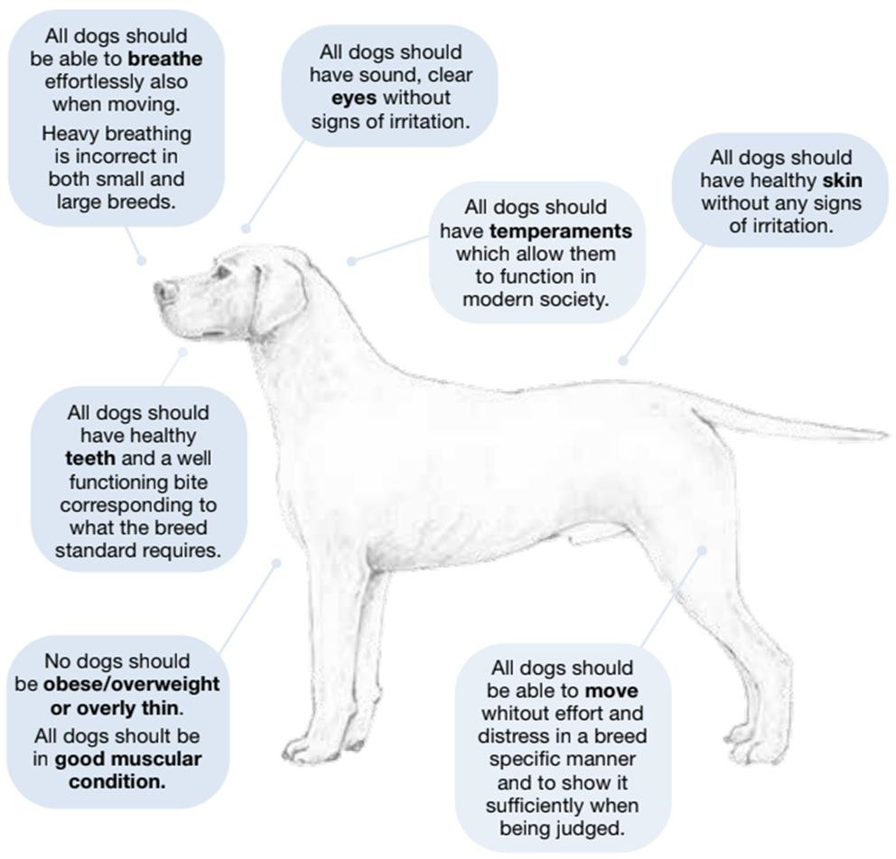
Basic to all dogs

Slide 4


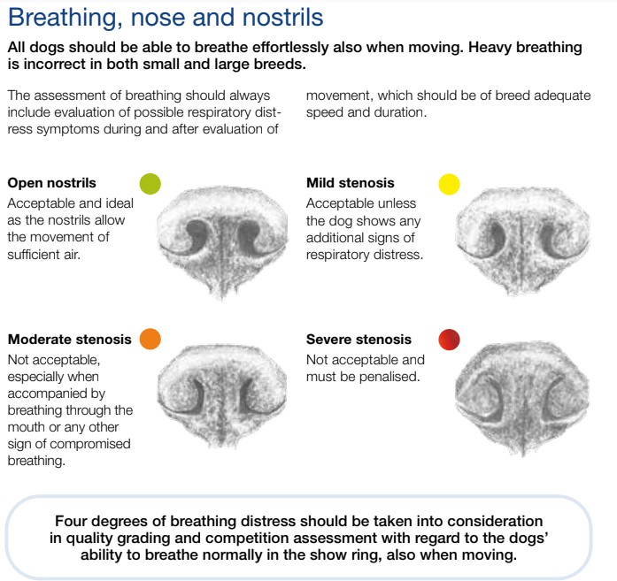
Basic to all dogs

Slide 5


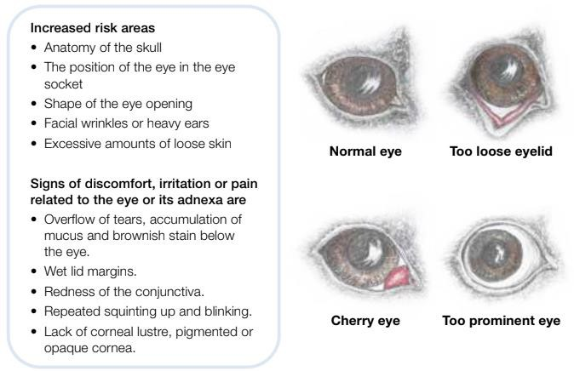
Basic to all dogs

Slide 6
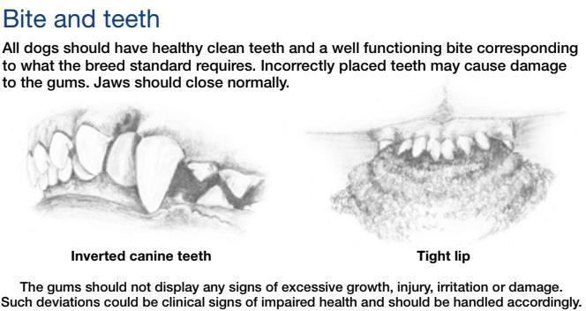
Basic to all dogs

Slide 7
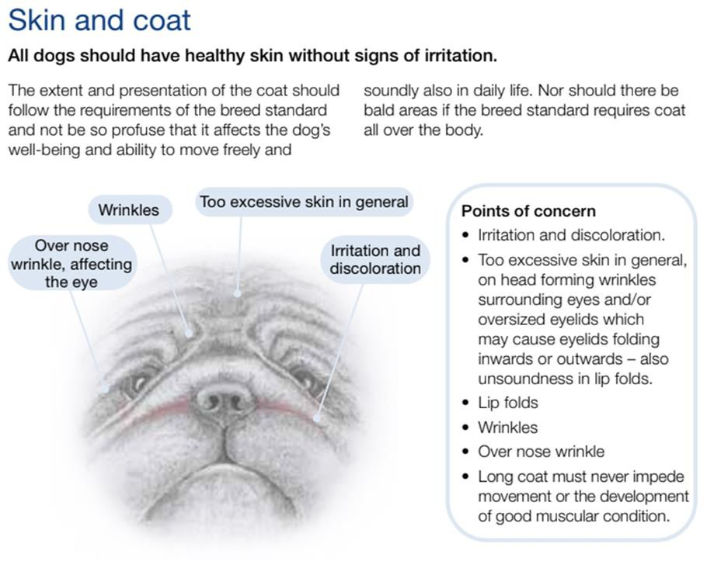
Basic to all dogs

Slide 8
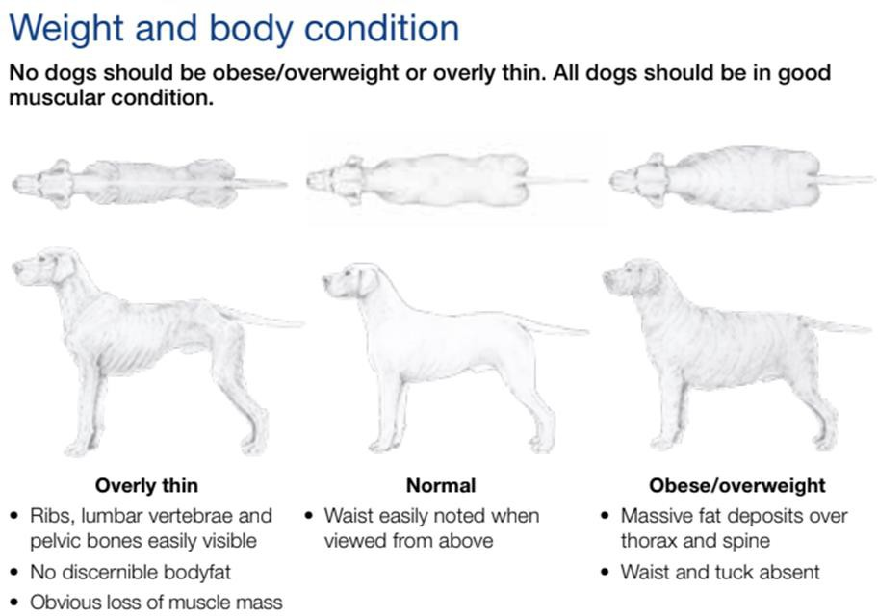
Basic to all dogs

Slide 9
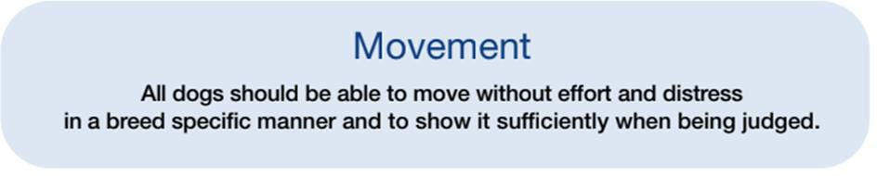


Basic to all dogs

Slide 10
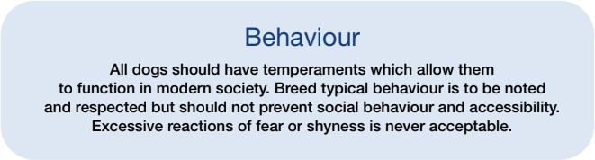
Basic to all dogs

Slide 11
Breed types
In many breeds, type and characteristics come from genetic mutations that cause specific anatomical features and should not be considered as normal canine anatomic variations.
It is of utmost importance that judges and breeders promote selection of animals which show optimal combination of healthy conformation and breed type
  Brachycephalic breeds
  Toy breeds
  Chondrodysplastic breeds
  Molossoid breeds

Slide 12
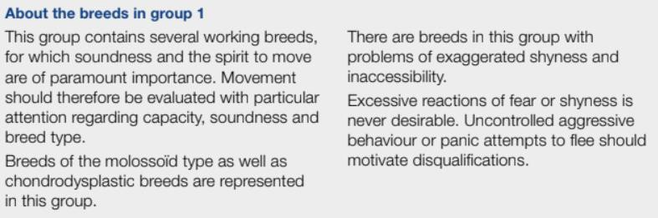
FCI group 1

Slide 13
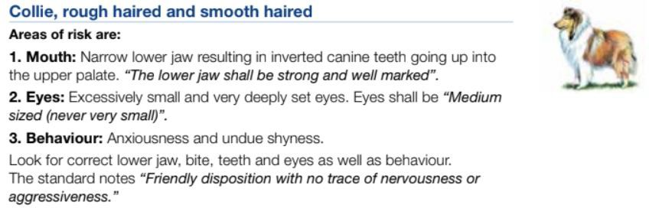
FCI group 1 examples:
Other breeds that require special attention:
  Czechoslovakian Wolfdog
  German Shepherd Dog
  Saarlos Wolfdog

Slide 14
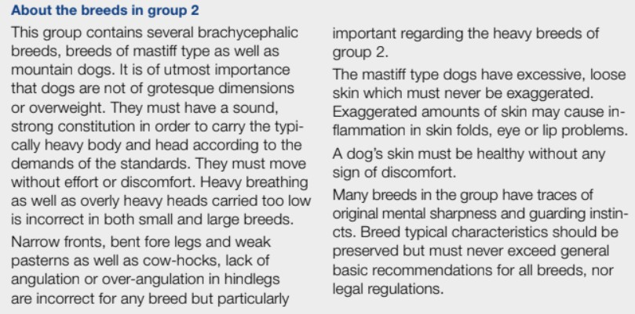
FCI group 2

Slide 15
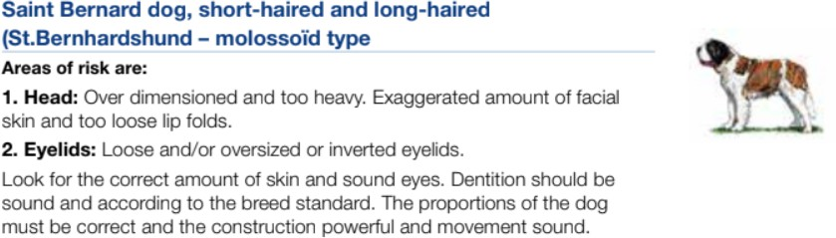
FCI group 2 examples:
Other breeds that require special attention:
Bulldog
Bullmastiff
Continental Bulldog
Douge de Bordeaux
German Boxer
Great Dane
Italian Cane Corse
Mastiff
Neapolitan mastiff
Shar Pei

Slide 16
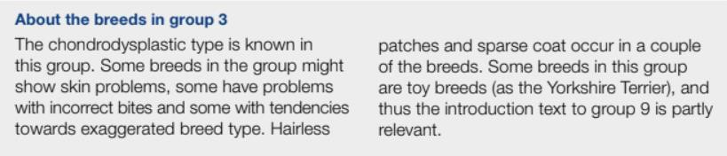
FCI group 3
Breeds that require special attention:
  Bullterrier/Miniature Bull Terrier
  Norwich Terrier
  Staffordshire Bull Terrier
  Yorkshire terrier

Slide 17
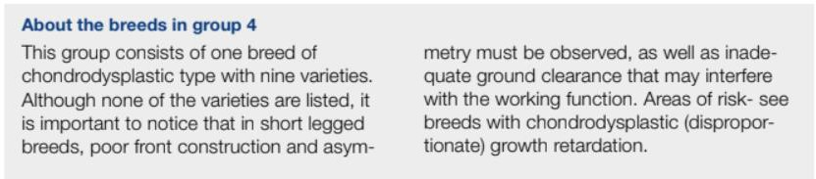
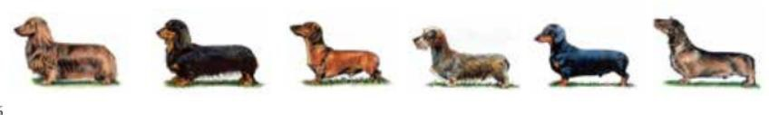

FCI group 4

Slide 18
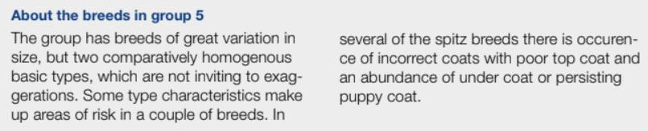
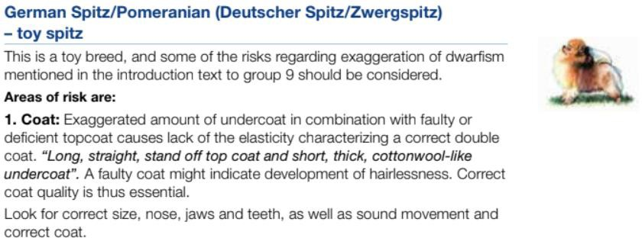
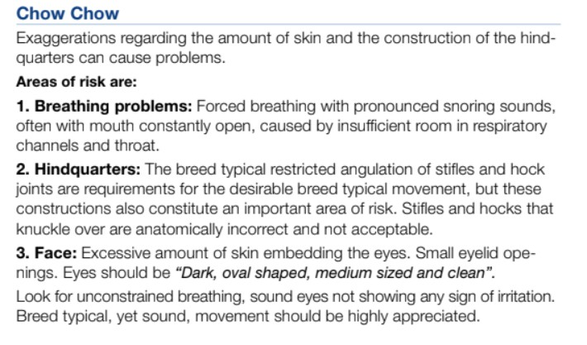

FCI group 5

Slide 19
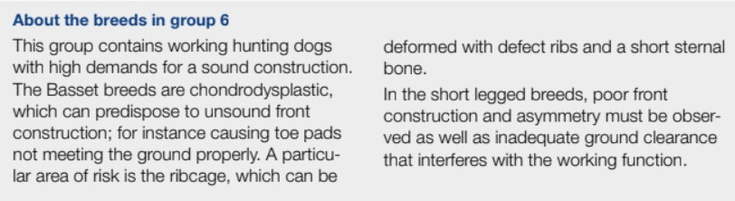
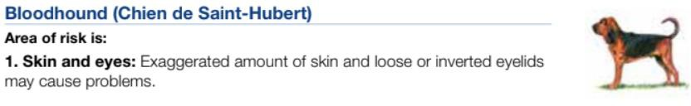
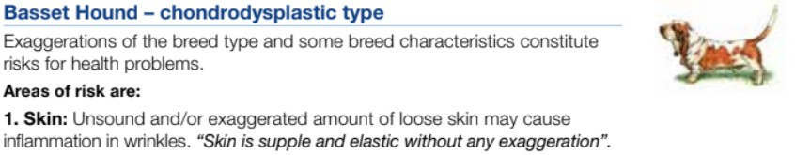
FCI group 6

Slide 20
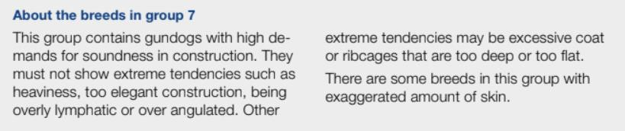
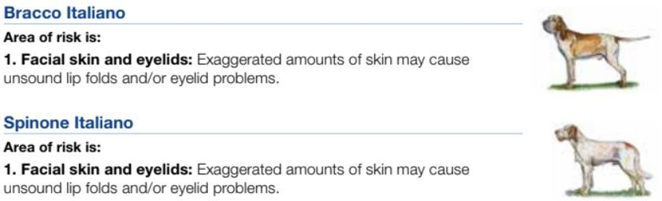
FCI group 7

Slide 21
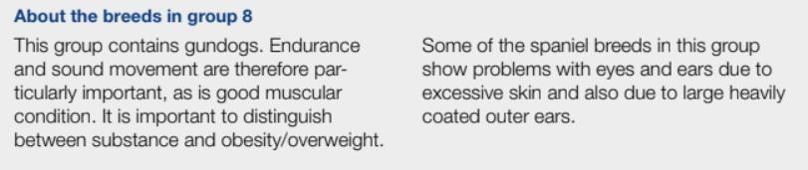
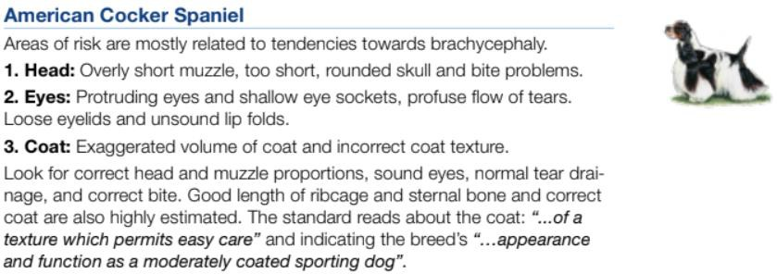
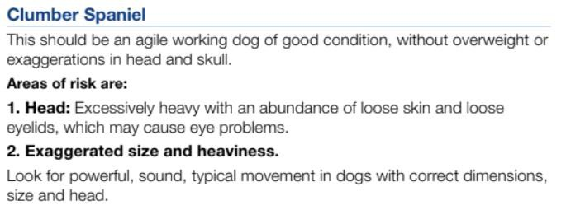
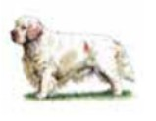
FCI group 8

Slide 22
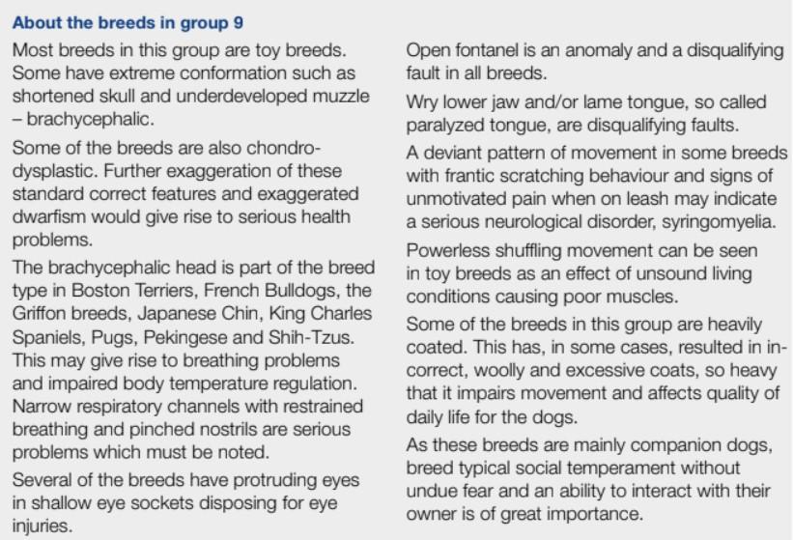
FCI group 9

Slide 23
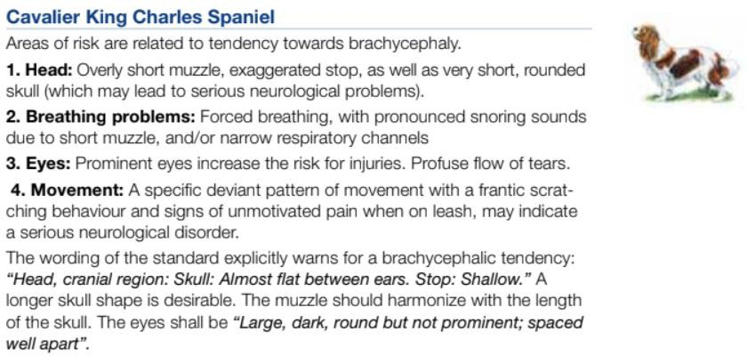
FCI group 9 examples:
Other breeds that require special attention:
  Belgian Griffon
Pekingese
Pug
Shih Tzu
Small Brabant Griffon
King Charles Spaniel
French Bulldog
Japanese Chin
Boston Terrier
Brussels Griffon
Chihuahua

Slide 24
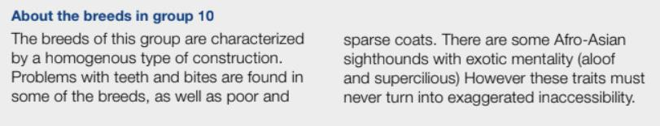
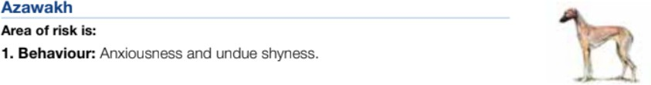
FCI group 10

Slide 25
WWW.FCI.BE

